Slide 1

BDA Mini Project Topic : Cars Pricing dataset analysis
By :
Samiran Bhattacharya PA41
Yash Rathore PA46
Aditya Rao PA19
Anunay Maheshwari PC60

Slide 2
Objectives
Execute simple as well as complex queries using the aggregation framework in MongoDB on our dataset.
Perform various visualizations using Tableau for better understanding of the data.

Slide 3
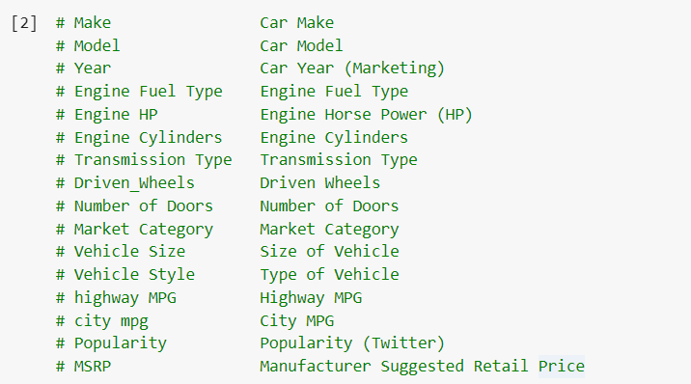
Dataset description

Slide 4
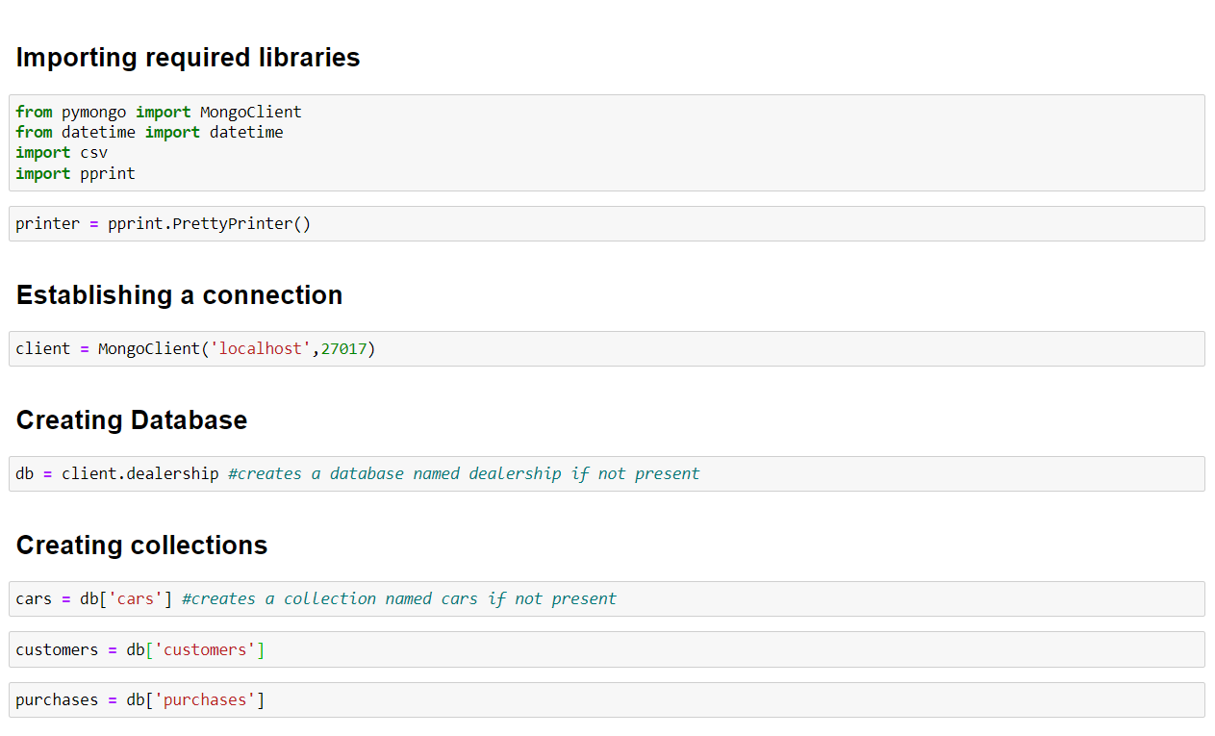
Implementation

Slide 5
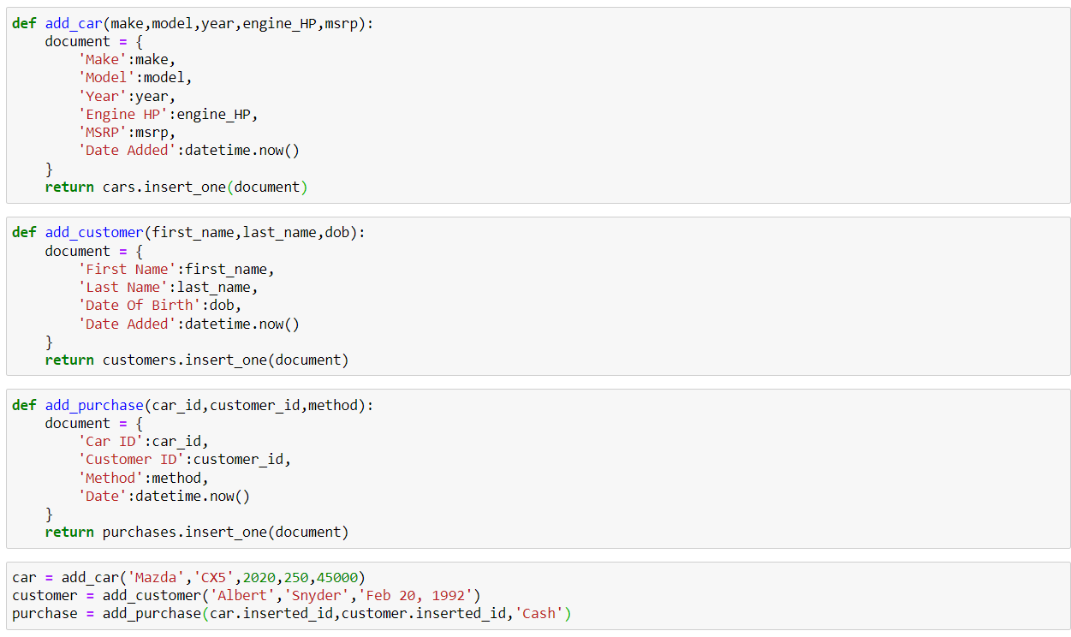
Creating functions for adding documents

Slide 6
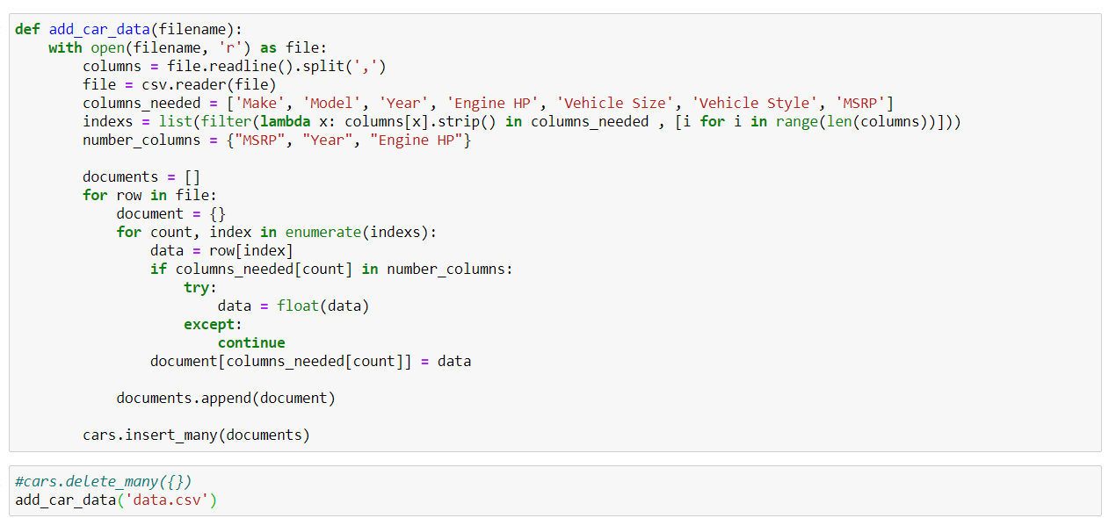
Reading dataset into MongoDB

Slide 7
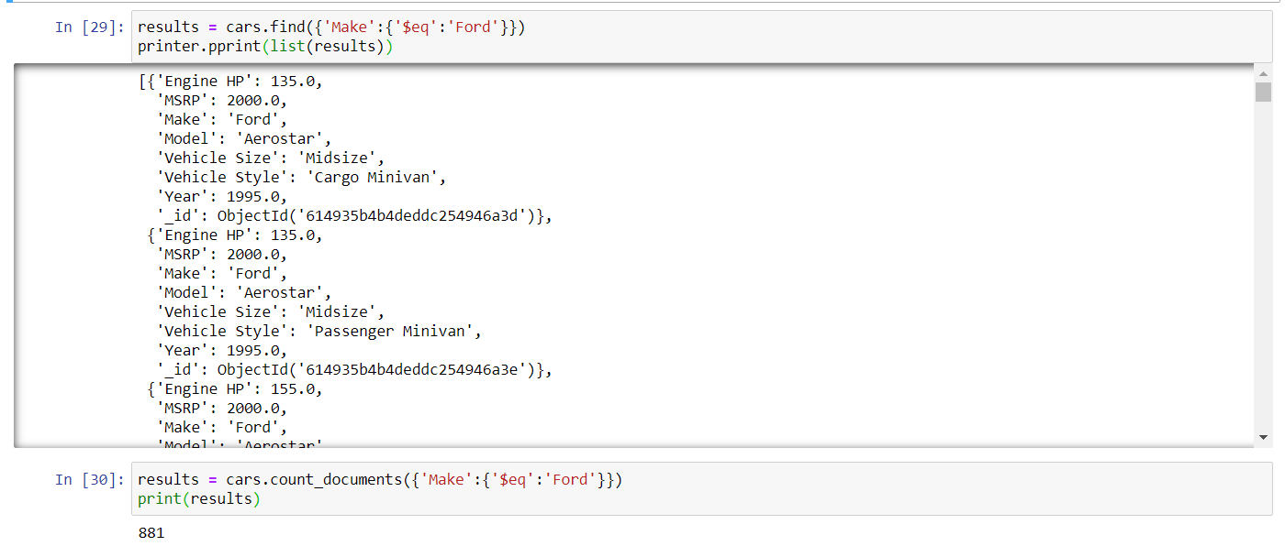
All cars manufactured by Ford

Slide 8
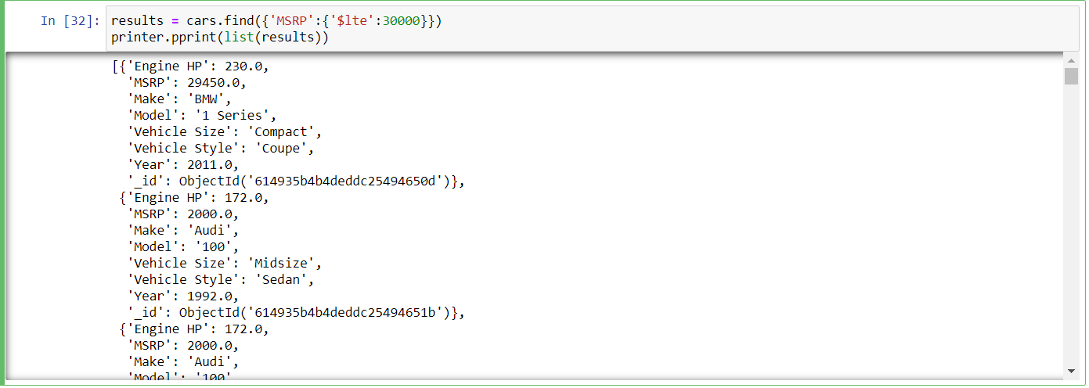
All cars priced 30000 or lower

Slide 9
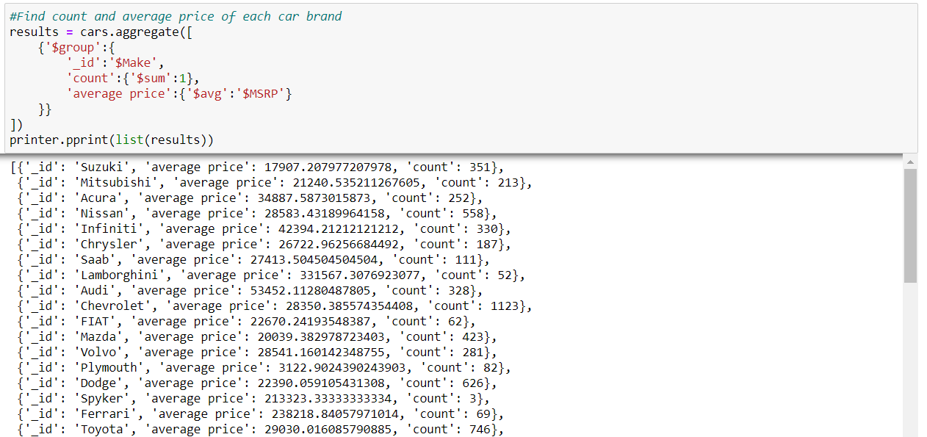
Average price of all car brands along with count

Slide 10
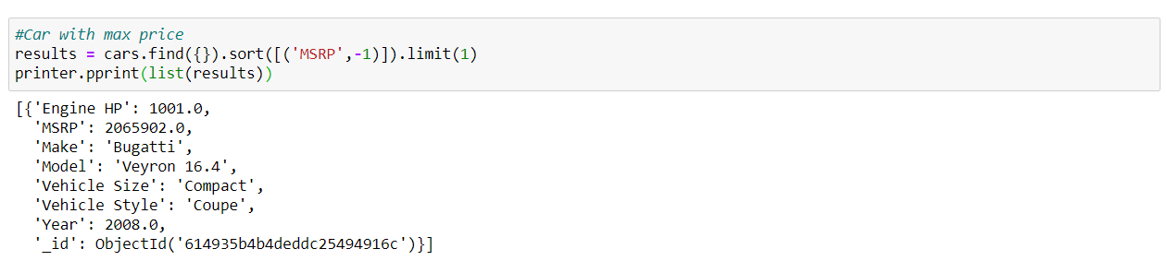
Car with max price

Slide 11
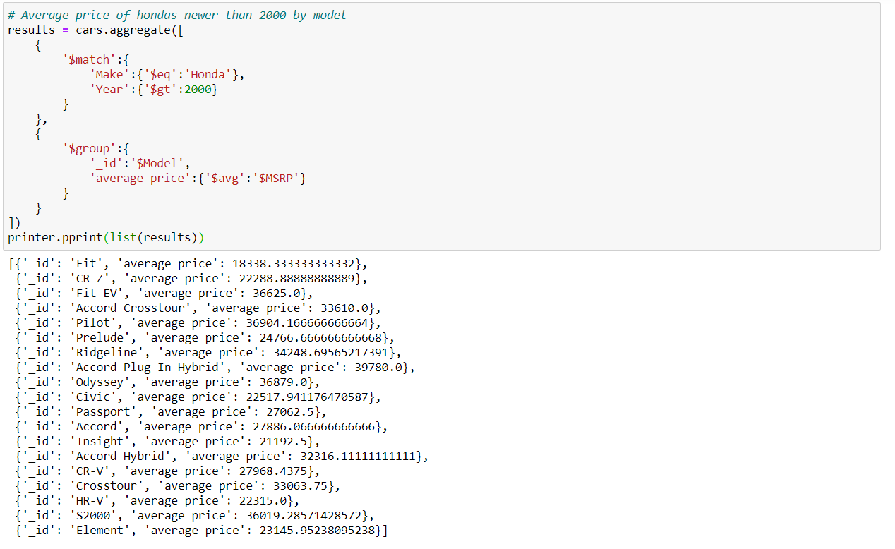
Average price of hondas newer than 2000 by model

Slide 12
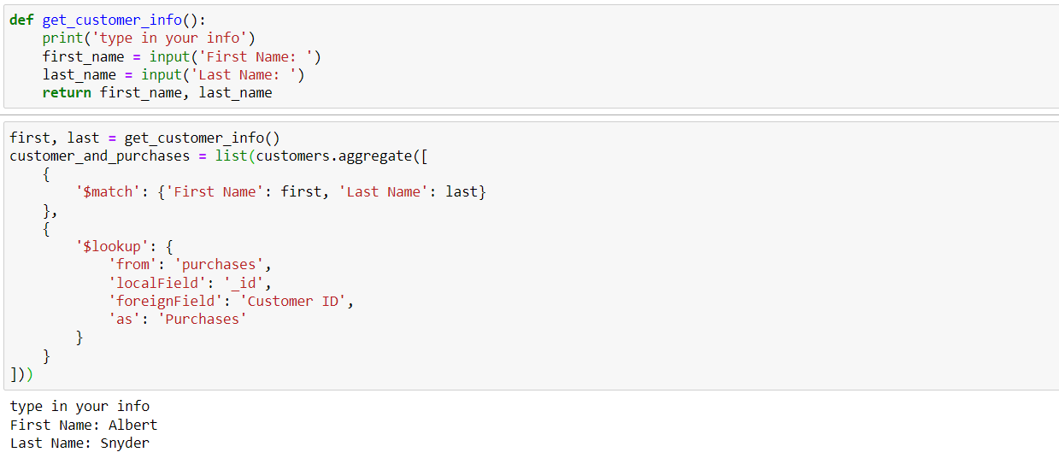
Finding all cars purchased by customer

Slide 13
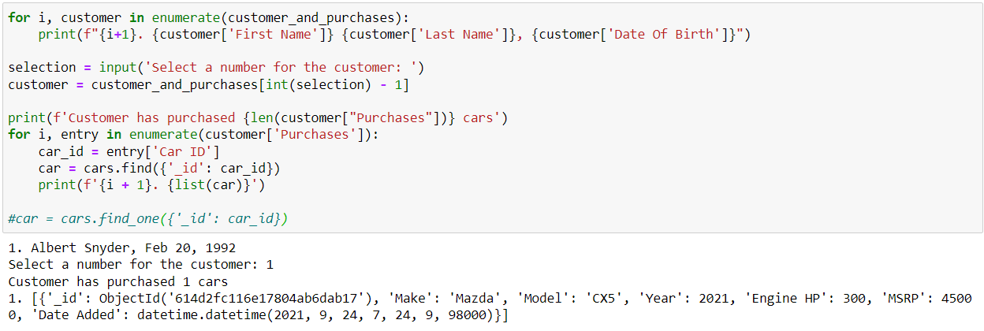
Finding all cars purchased by customer

Slide 14
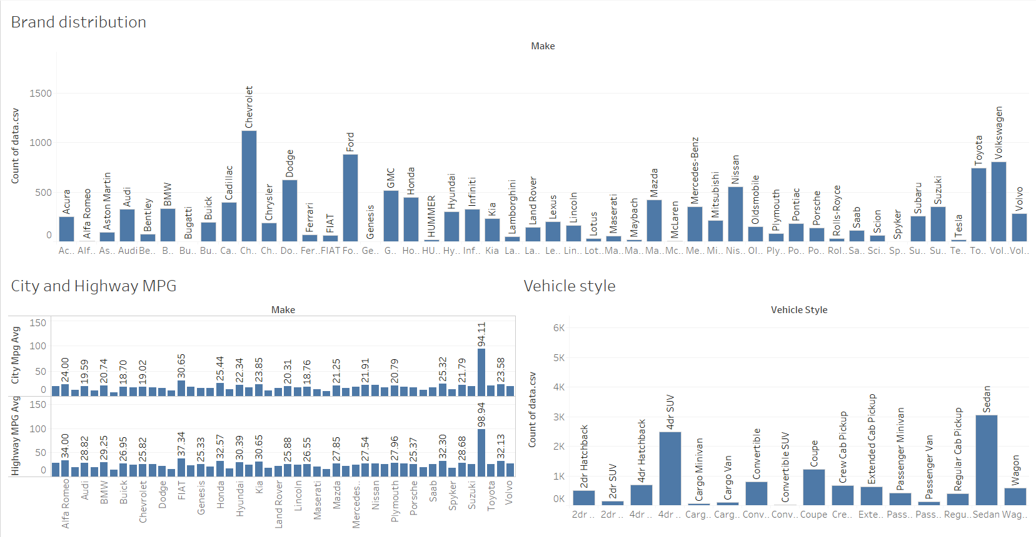

Slide 15
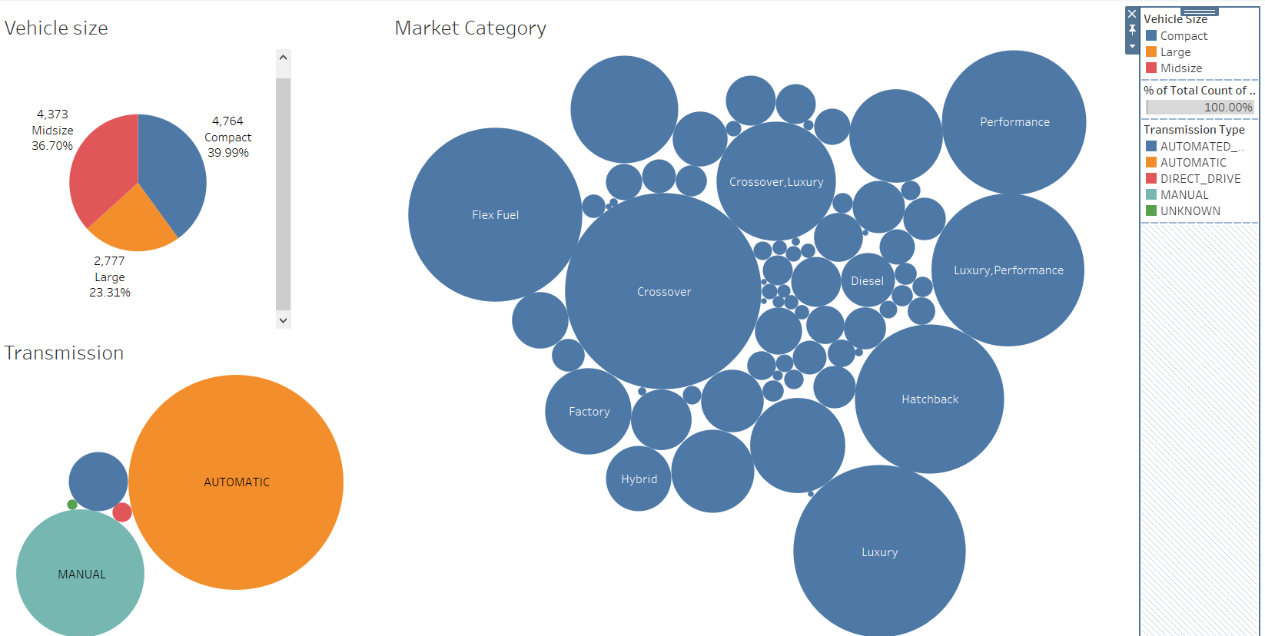

Slide 16
Inferences
Major car brands in dataset are Chevrolet, Ford, Volkswagen, Dodge and Nissan.
Most cars are either compact or midsize.
Majority cars have automatic transmission.
Tesla cars have the highest MPG in both city (94.11) and highway (98.94).
Generally vehicle styles are either Sedan or 4dr SUV.
Predominant market categories are Crossover, Flex Fuel, Hatchback, Luxury, Performance.

Slide 17


